Slide 1

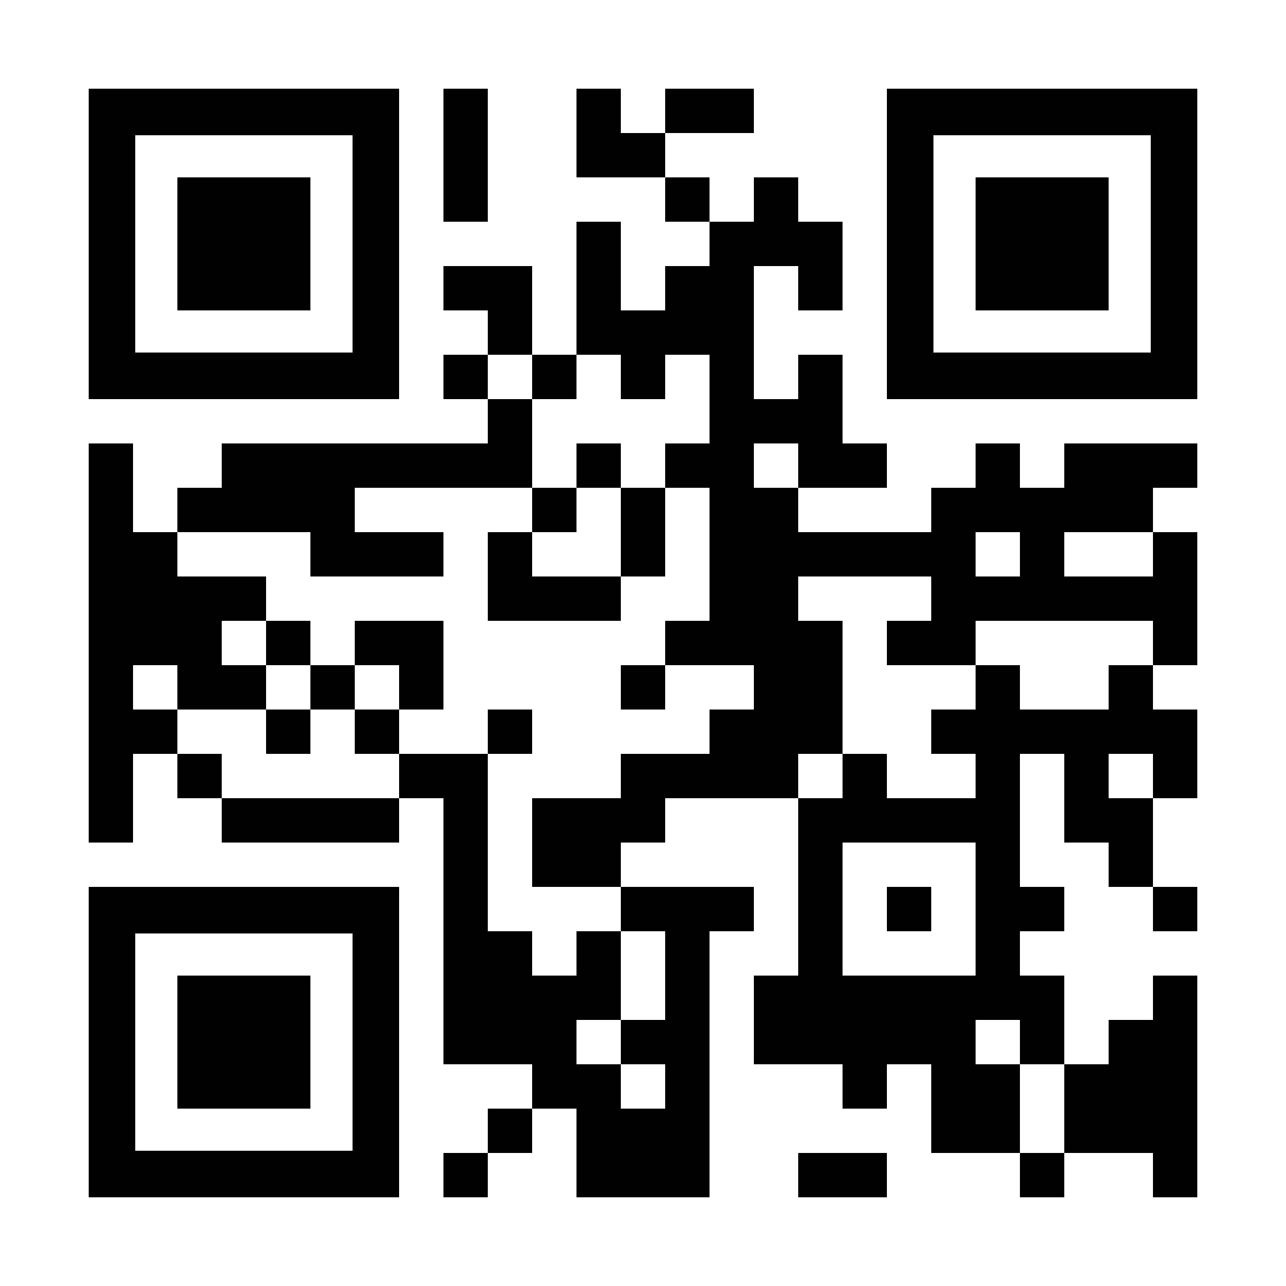
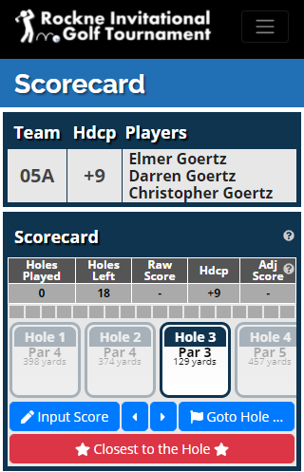
Rockne Invitational Golf Tournament – Electronic Scorecard
Rockne Invitational Golf Tournament – Electronic Scorecard
Go to the Website. Either (1) scan the QR code on the right or (2) go to the website http://rockne.golf. Do NOT add .com to the end of the address.
Log In. Either (1) select Team Log In from the menu bar, or (2) find and click the button at the bottom of the home page that says Log In. Then enter your team credentials shown below:
Go to the Website. Either (1) scan the QR code on the right or (2) go to the website http://rockne.golf. Do NOT add .com to the end of the address.
Log In. Either (1) select Team Log In from the menu bar, or (2) find and click the button at the bottom of the home page that says Log In. Then enter your team credentials shown below:
Team:
Password:
Start Hole:
Players:
Team:
Password:
Start Hole:
Players:
Go to the Electronic Scorecard. In the menu bar, select Scorecard.
Enter Data. Make sure you are on the correct hole you are playing. Enter scores and record designated Closest to the Hole and Longest drives.
Go to the Electronic Scorecard. In the menu bar, select Scorecard.
Enter Data. Make sure you are on the correct hole you are playing. Enter scores and record designated Closest to the Hole and Longest drives.
This is the upper part of the Electronic Scorecard. Below, find up-to-date leader boards.
Use Menu button to bring up the navigation menu.
This is the upper part of the Electronic Scorecard. Below, find up-to-date leader boards.
Use Menu button to bring up the navigation menu.
Your Team Info: team number, handicap and player names
Your Team Info: team number, handicap and player names
In-flight tournament data (holes played, raw score, adjusted score, etc.)
In-flight tournament data (holes played, raw score, adjusted score, etc.)
Get scorecard help.
Get scorecard help.
Your Scrolling
Scorecard
Your Scrolling
Scorecard
Hit Input Score button to enter score for the current hole.
Hit Input Score button to enter score for the current hole.
Go to desired hole by (1) using arrow buttons, (2) hitting Goto Hole button or (3) dragging scrolling scorecard left or right and clicking on hole.
Go to desired hole by (1) using arrow buttons, (2) hitting Goto Hole button or (3) dragging scrolling scorecard left or right and clicking on hole.
+0
-1
3
+0
-1
3
Enter closest to the hole and longest drive on specified holes.
Enter closest to the hole and longest drive on specified holes.
1
2
1
2
Update Your Player Profile. At some point today, select Players from the menu bar and update all team member contact information.
Update Your Player Profile. At some point today, select Players from the menu bar and update all team member contact information.

Slide 2
This is the upper part of the Electronic Scorecard. Below, find up-to-date leader boards.
Use Menu button to bring up the navigation menu.
Your Team Info: team number, handicap and player names
In-flight tournament data (holes played, raw score, adjusted score, etc.)
Get scorecard help.
Your Scrolling
Scorecard
Hit Input Score button to enter score for the current hole.
Go to desired hole by (1) using arrow buttons, (2) hitting Go to Hole button or (3) dragging scrolling scorecard left or right and clicking on hole.
+0
-1
3
Enter closest to the hole and longest drive on specified holes.
1
2

